Slide 1
Occupational therapy & sensory integration equipment guide
Dawn House school
nIcole Mason-Khosla
Senior OT,
Sensory integration practitioner

Slide 2
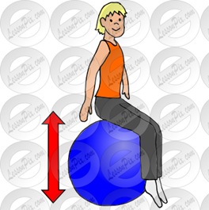
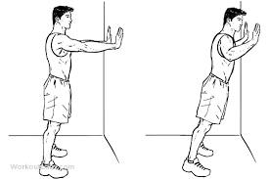
A sensory diet
A sensory diet is a tailored activity programme designed to meet a child's specific sensory needs and to help them to achieve their full potential.
It aims to provide the "just right" combination of sensory input/ ‘feeling green’ to achieve and maintain optimal levels of arousal and performance in the nervous system.
Key points:
Regular movements throughout the day at scheduled times.
The child is an active participant and needs to enjoy doing the activities.
Must be customised for individual needs and responses.
Not every activity in the sensory diet has to be completed each time.
Vary from 30 seconds to several minutes.
Must be prescribed by the SI practitioner.

Slide 3
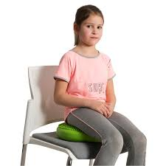
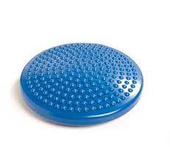
Wobble cushion
What is it? A wobble cushion are small round inflatable cushions, strong enough to sit or stand on. When sat on the cushion it provides a ‘wobble’ encouraging the student to engage their back and core muscles.
Why are they prescribed? The cushion works upon ones core stability and provides proprioceptive, tactile and vestibular movements that they may be seeking. In turn this is in place to support regulation allowing the individual to focus and attend to an array of tasks.

Slide 4
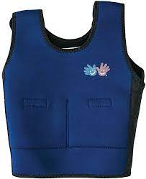
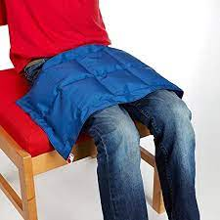
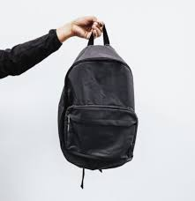
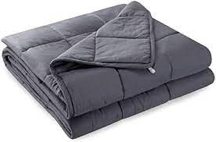
Weighted equipment
What is it? Weighted equipment is prescribed and can present in a variety of different aids, on average it is recommended that they are used twice a day for up to fifteen minutes. Please note this may vary from each individual dependent on need and assessment.
Why are they prescribed? Weighted equipment is in place to provide proprioceptive input to the brain, which is to have a calming and organising impact upon the nervous system. Weighted equipment can be seen in many different forms, for example: a weighted blanket, a weighted lap belt, a weighted back pack and a weighted vest/ jacket.

Slide 5
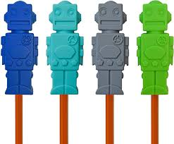
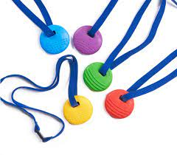
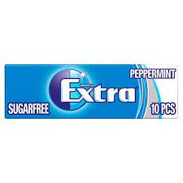
Chew buddy
Signs to look out for: Some children may be observed to bite or chew on edible and non-edible items. This is highlighting that they are seeking oral motor feedback, this is a form of self-stimulating behaviour. The mouth has the highest concentrations of nerve endings which helps one explore, this is why babies and young children often put items in their mouth.
What may be prescribed and why? Students may be prescribed chew items including: A chew buddy, a vibrating chew, chewing gum, and a chew pen top. The OT may also make further recommendations including: having a crunchy snack, drinking from a sports bottle or from a straw and an array of oral motor games.
Chewing has a calming impact and in turn may have a positive impact upon attention and focus.

Slide 6
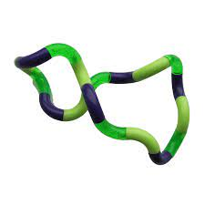
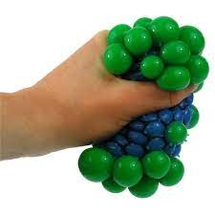
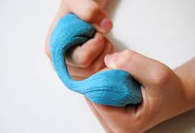
TACTILE toys
What are they? Fiddle toys provide tactile input to support regulation and thus promote focus, attention and feeling calm. When a tactile tool is in situ it can reduce anxiety, promote engagement in class and they can be fantastic for fine motor development.
Why may they be prescribed: Tactile toys are a prescribed aid, examples include: putty, play-doh, tangle and a squeezy ball. It is important to note that not every toy will be suitable for all. Some may prefer ones which feel a certain way whilst others may not be able to manage ones which make a repetitive sound. Prescriptions are bespoke and reviewed on a regular basis.

Slide 7
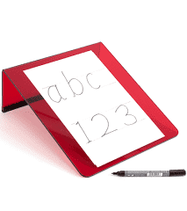
Handwriting slope
What is a handwriting slope? A handwriting slope encourages students to have a better working posture and wrist position.
What benefits does the aid bring:? The slope elevates the paper off the table and students should be encouraged to write whilst seated in the optimum position (feet on stable group and sat upright).

Slide 8
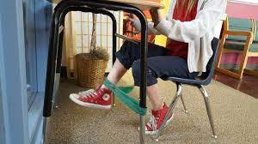
Theraband
Signs to look out for: Some students are assessed to be sensory seekers and may require feedback in their large muscles located within the legs during seated tasks. The student may be observed to be kicking their legs, sitting on their legs or unable to sit for lessons.
Why Theraband? The SI trained therapist may place TheraBand (TheraBand strength determined at assessment) on the chair legs. The extra sensory feedback alerts the body providing proprioceptive feedback to support body awareness. This should work towards decreasing distraction and any unsafe movements. The student is able to place pressure against the band giving their legs the feedback that they are seeking.

Slide 9
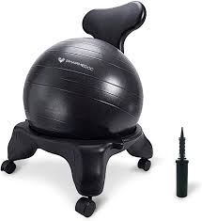
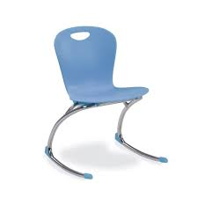
Ball and zuma rocker chair
Why would a student be prescribed specialist seating?
The purpose of having sensory seating is to allow children to gain the movement that they are seeking whilst in the classroom. The chairs allow the child to move in an appropriate way so rather than rocking on a chair and potentially being in danger these chairs provide the movement in a safe and appropriate manner. Chairs as such can become tiring and it is important to note that they do not need to be in situ all day and for every lesson. The chair can be used for a 30 minute period during the morning and afternoon, The SI therapist and or OT will monitor its use to ensure it is suitable and effective for the child allowing them to gain the vestibular, proprioceptive and tactile feedback that they are seeking.

Slide 10
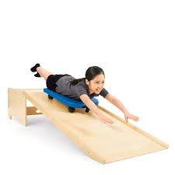
The scooter board
What are the benefits of a scooter board? Core strength/core stability is the foundation to all movements. OT may use the scooter board within a sensory diet, OT session and SI session. Areas which may be worked upon include: upper body strength, motor planning, timing, sequencing, trunk rotation, hand strength, mobility and crossing the midline. It is important to note that the scooter board is also a fantastic way to incorporate speech through giving directions!

Slide 11
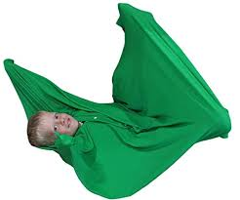
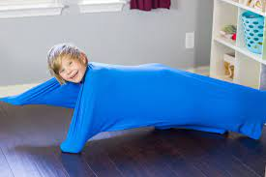
Body sock
What is a body sock? Body socks are designed to aid with sensory regulation. It can help children struggling with sensory difficulties to maintain calm while learning the skill of discovering their own body awareness. A sensory sock is a full body enclosed sock that’s designed to provide proprioceptive and deep pressure using a fabric that fully encloses the entire body. The head remains open, and the whole premise of these body socks is to help aid children with sensory processing difficulties. The sock can be child led or used for a therapist led game/task.

Slide 12
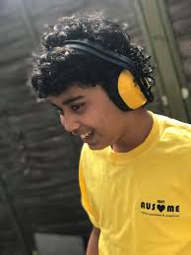
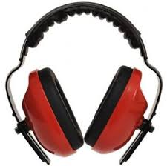
Ear defenders
The benefits of ear defenders: Children with sensory processing difficulties may have sound sensitivities. Ear defenders work to reduce/dull sound to promote regulation, focus and function. Initially children may need support to access the aid however in time it is hoped that their awareness of sensory preferences is developed allowing them to access them as and when required. Some children disclike the tactile input that they provide and so alternative aids can be explored including ear plugs and music through headphones.

