Slide 1
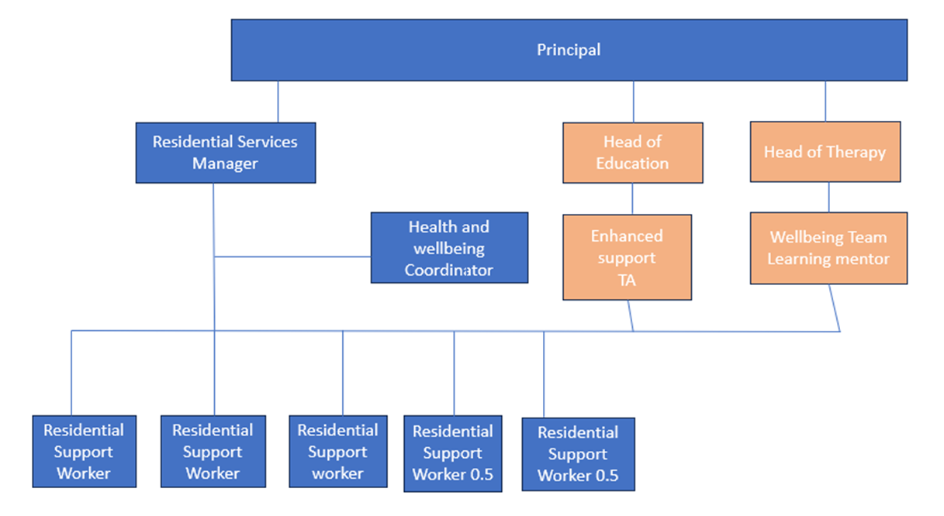
Residential Structure 2023

