Slide 1
Dawn House School KS4/5 Options for 2024-25
…offering a range of exciting opportunities for all
speechandlanguage.org.uk
“Working towards
successful futures”
Follow us @SpeechAndLangUK

Slide 2
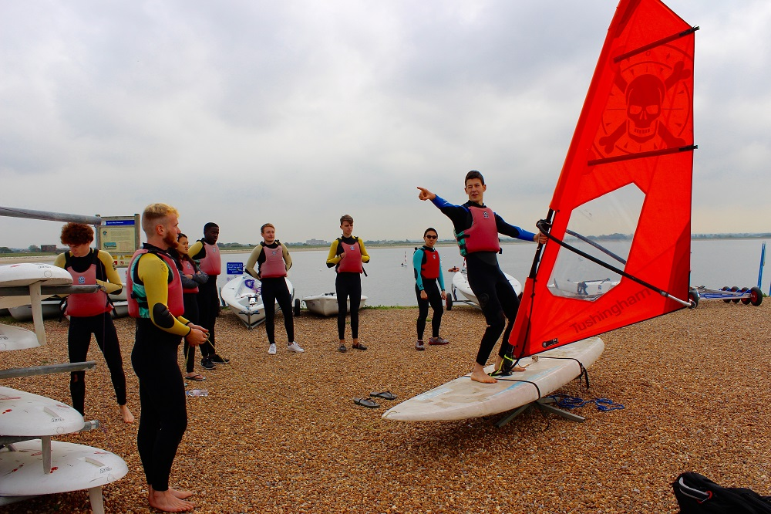
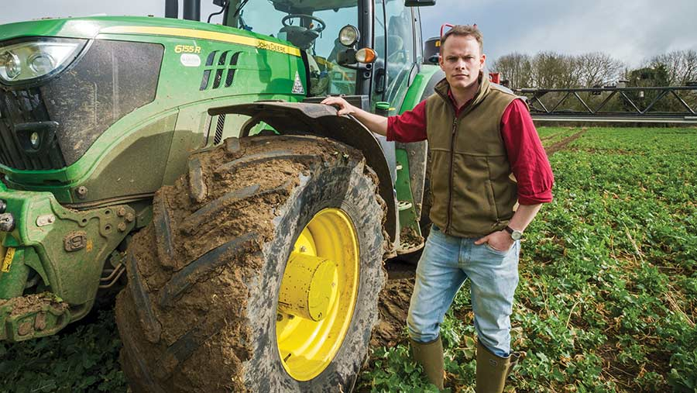
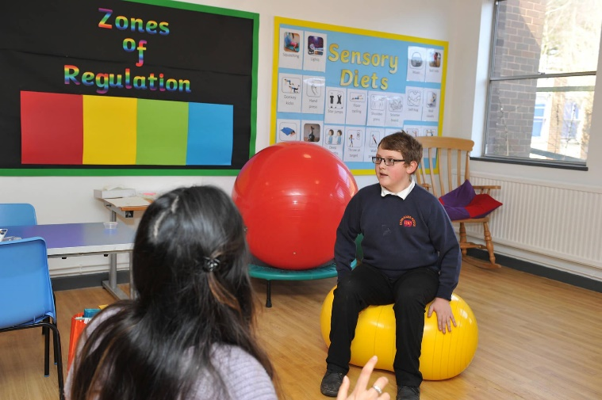
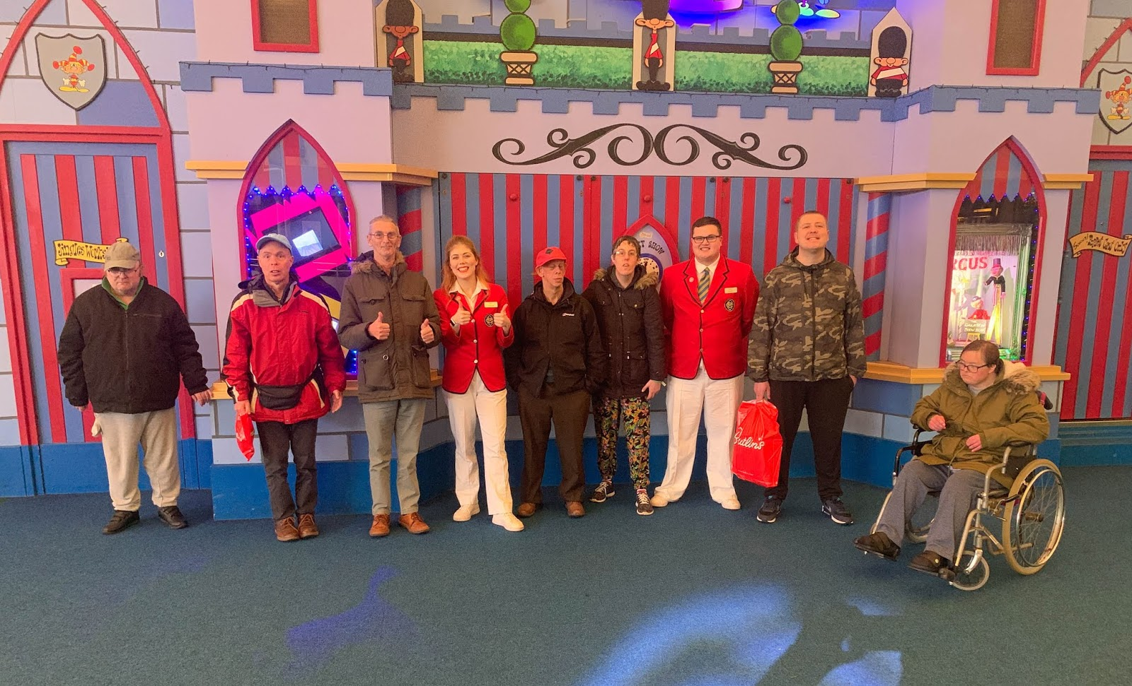
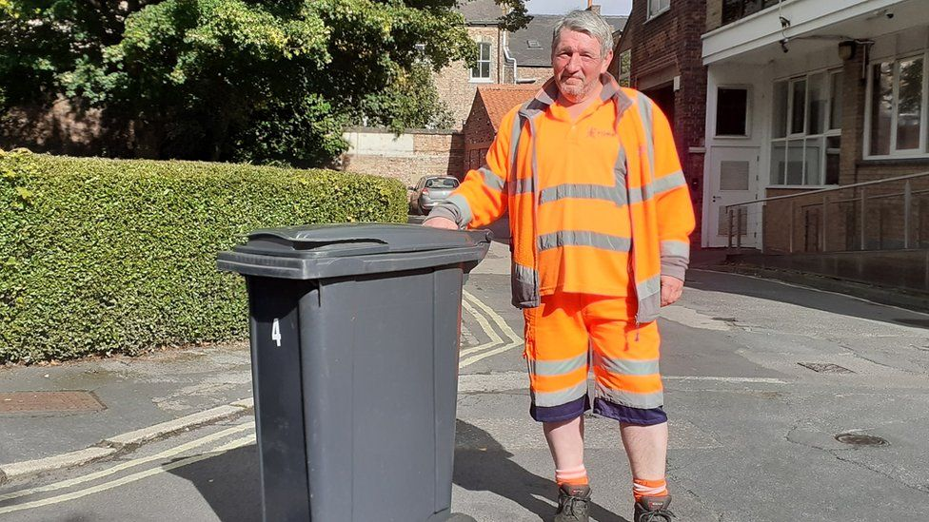
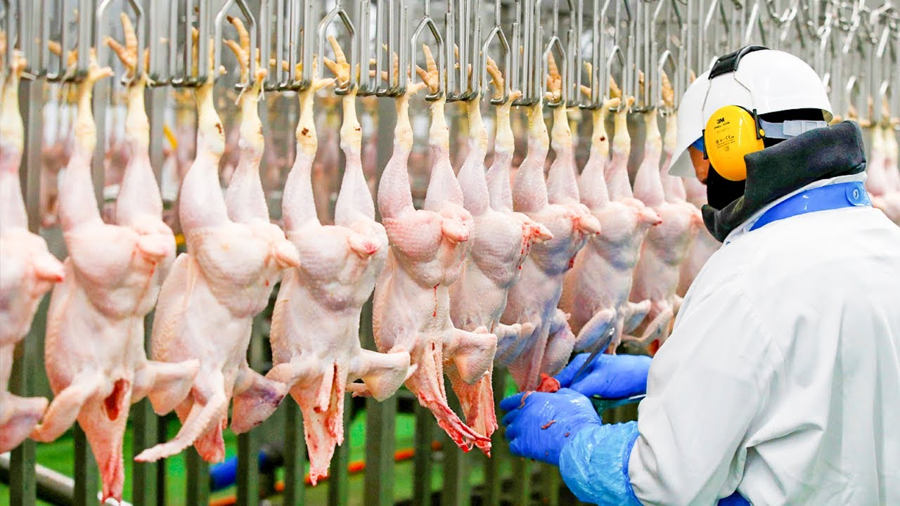
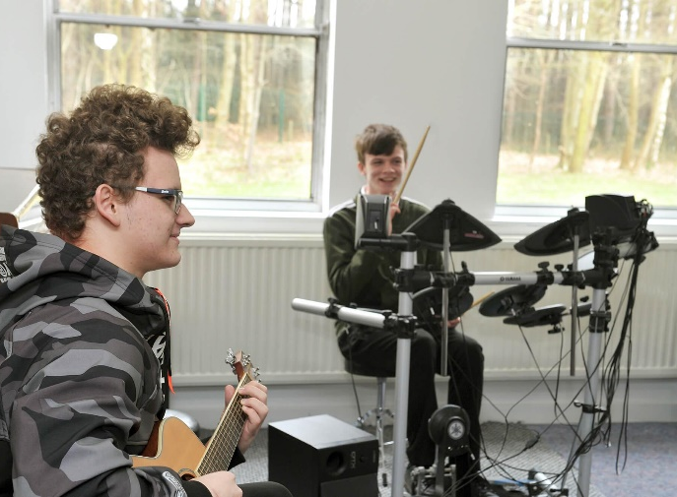
“Working towards successful futures”

Slide 3
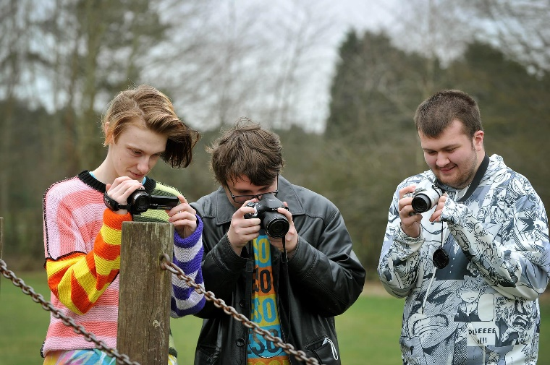
Selecting your Options:
“Working towards successful futures”

Slide 4
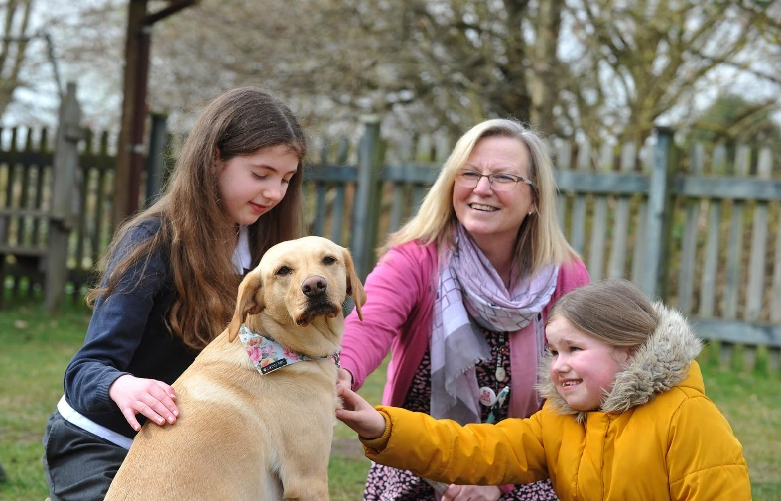
Options at Dawn House School:
“Working towards successful futures”

Slide 5
“Working towards successful futures”

Slide 6
Option Block 1 - Monday Afternoon:
“Working towards successful futures”

Slide 7
Option Block 2 - Tuesday Afternoon:
“Working towards successful futures”

Slide 8
Option Block 3 - Thursday Afternoon:
“Working towards successful futures”

Slide 9
Option Block 3 - Friday Morning:
“Working towards successful futures”

Slide 10
Next Steps:
Please complete the options sheet and return to school as soon as possible. For each option block identify a 1st and 2nd choice option.
If you would like further clarification, please do not hesitate to get in touch with school and we will discuss this in further detail.
This is a very exciting time where you get to choose the subjects you are passionate about. Be excited, you are lucky to have such a diverse selection of subjects on offer to you!
We will now move into the Sports Hall and offer you the opportunity to view pupils work and speak to the teachers about the course they’re offering
“Working towards successful futures”

Slide 11
“Working towards
successful futures”

